Slide 1
Punch the Red.
Ozelot Vanilla - 1162623
Zhang Aohan - 1162827
Zhang Chenyueyi - 1163013

Slide 2
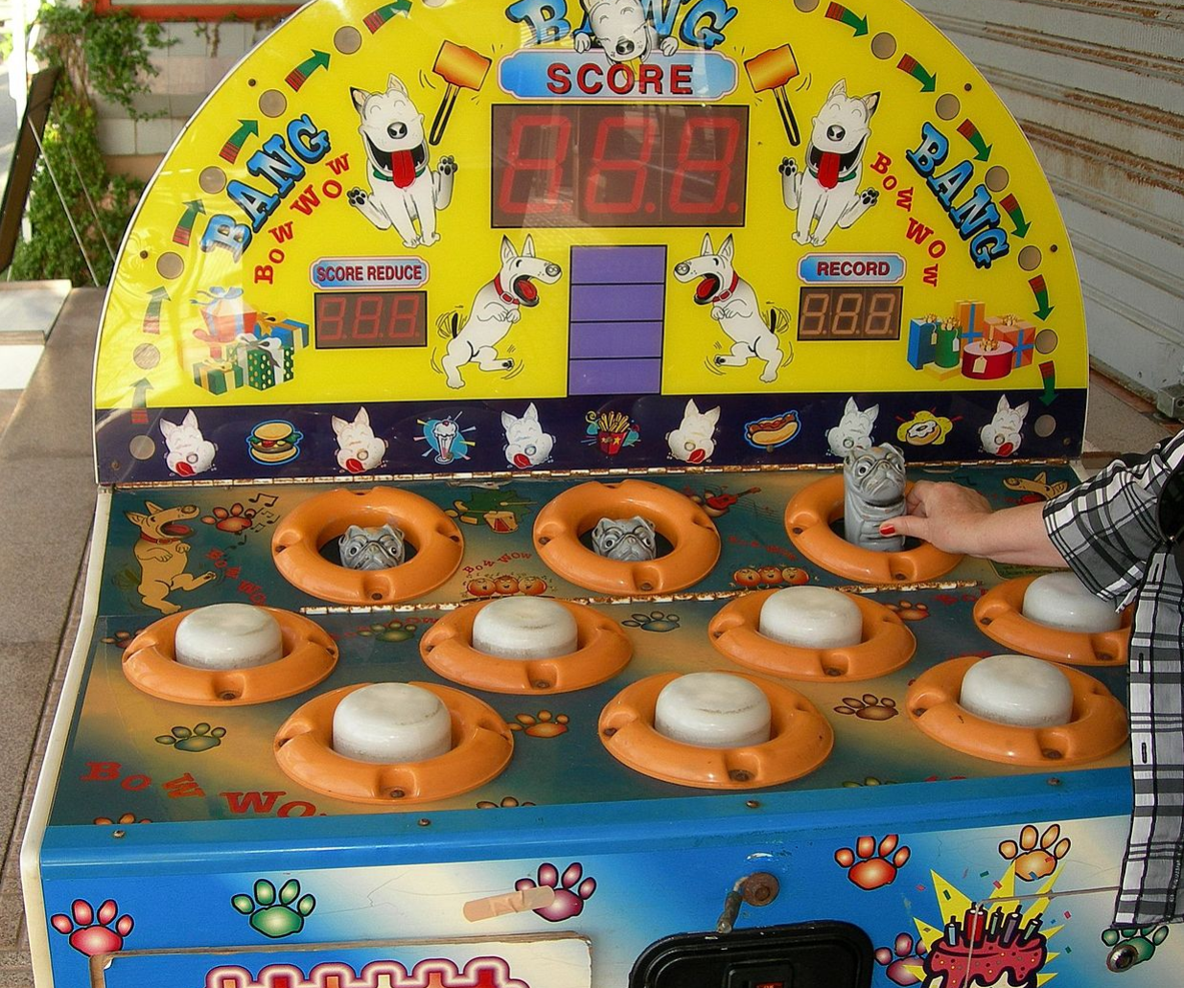
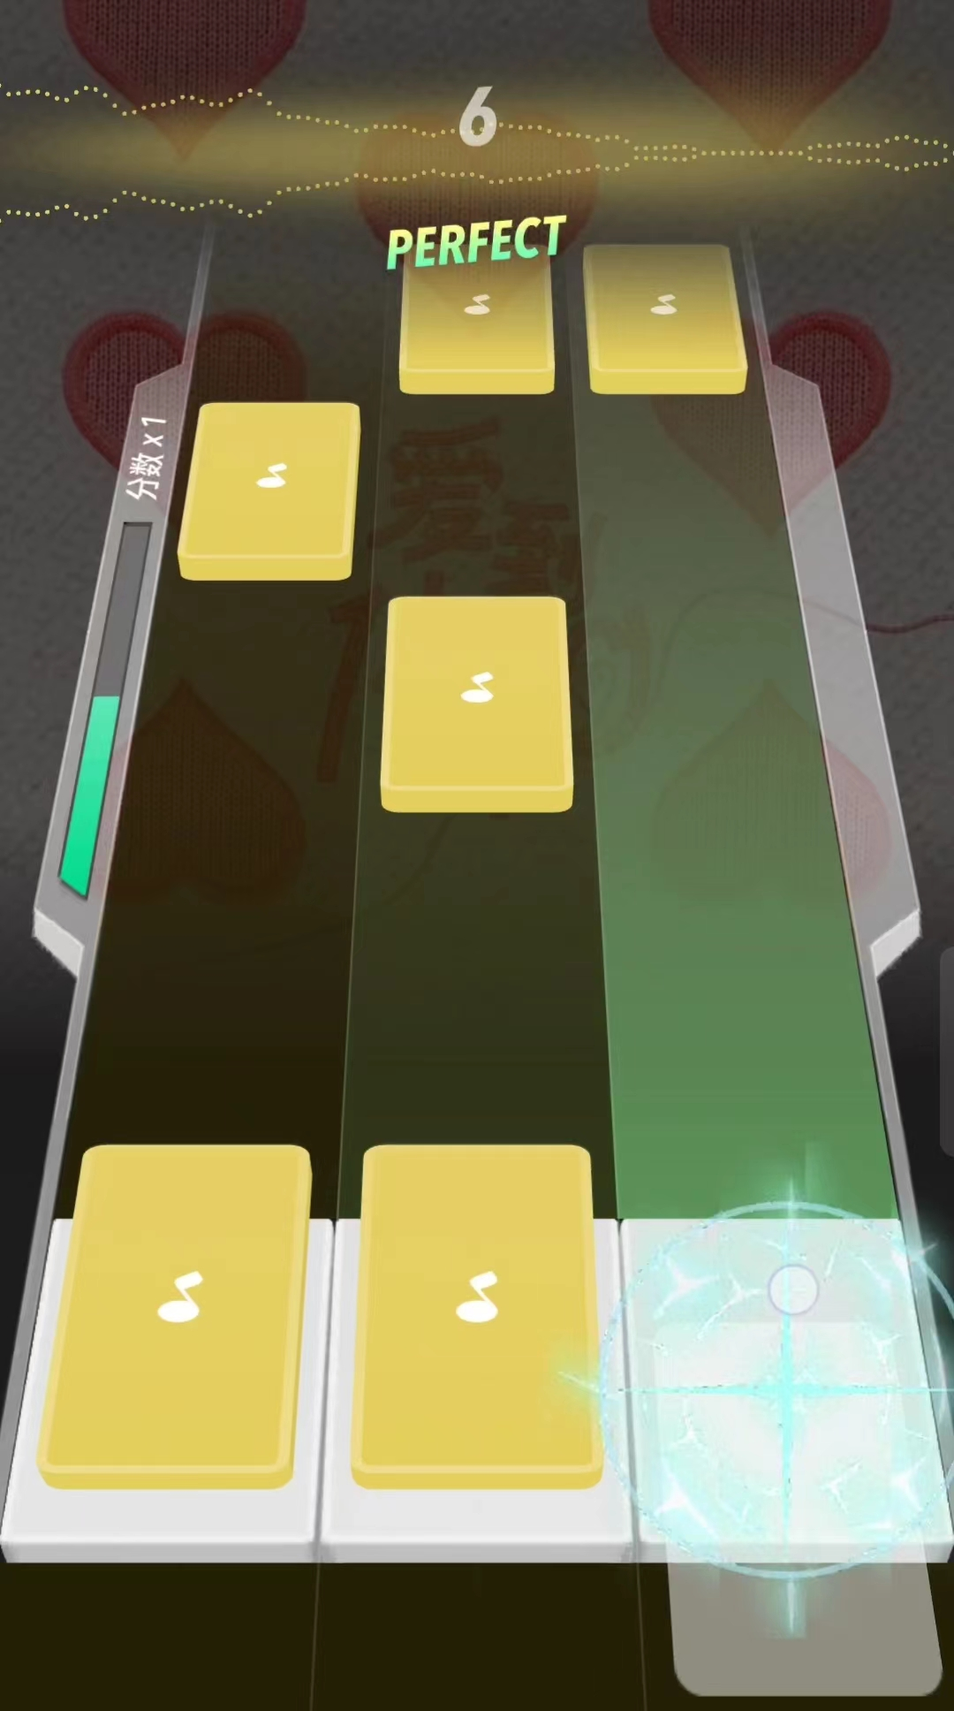
Source of Inspiration
Whack-a-mole game - Hit the local rat accurately and quickly when it appears and lights up
Piano game - Press the keys when the musical mark is infinitely close to the baseline
https://zh.wikipedia.org/wiki/File:Whac-A-Mole-Dog.jpg
QQ music

Slide 3
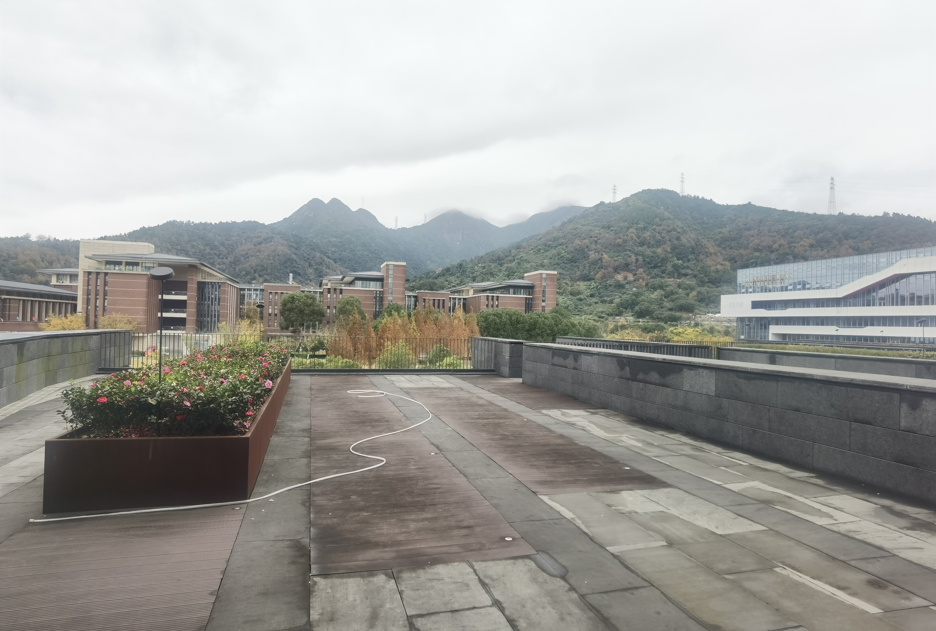
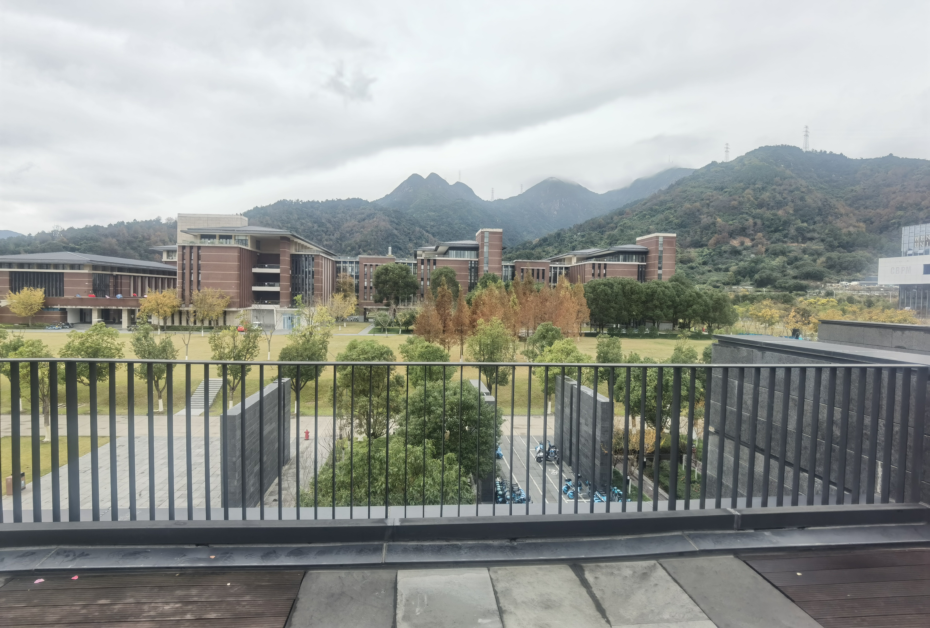
Application Sence
The big lawn on campus——
The lights are placed on this lawn, because here, the lights can be seen from the upstairs of GEH, CBPM and GHK

Slide 4
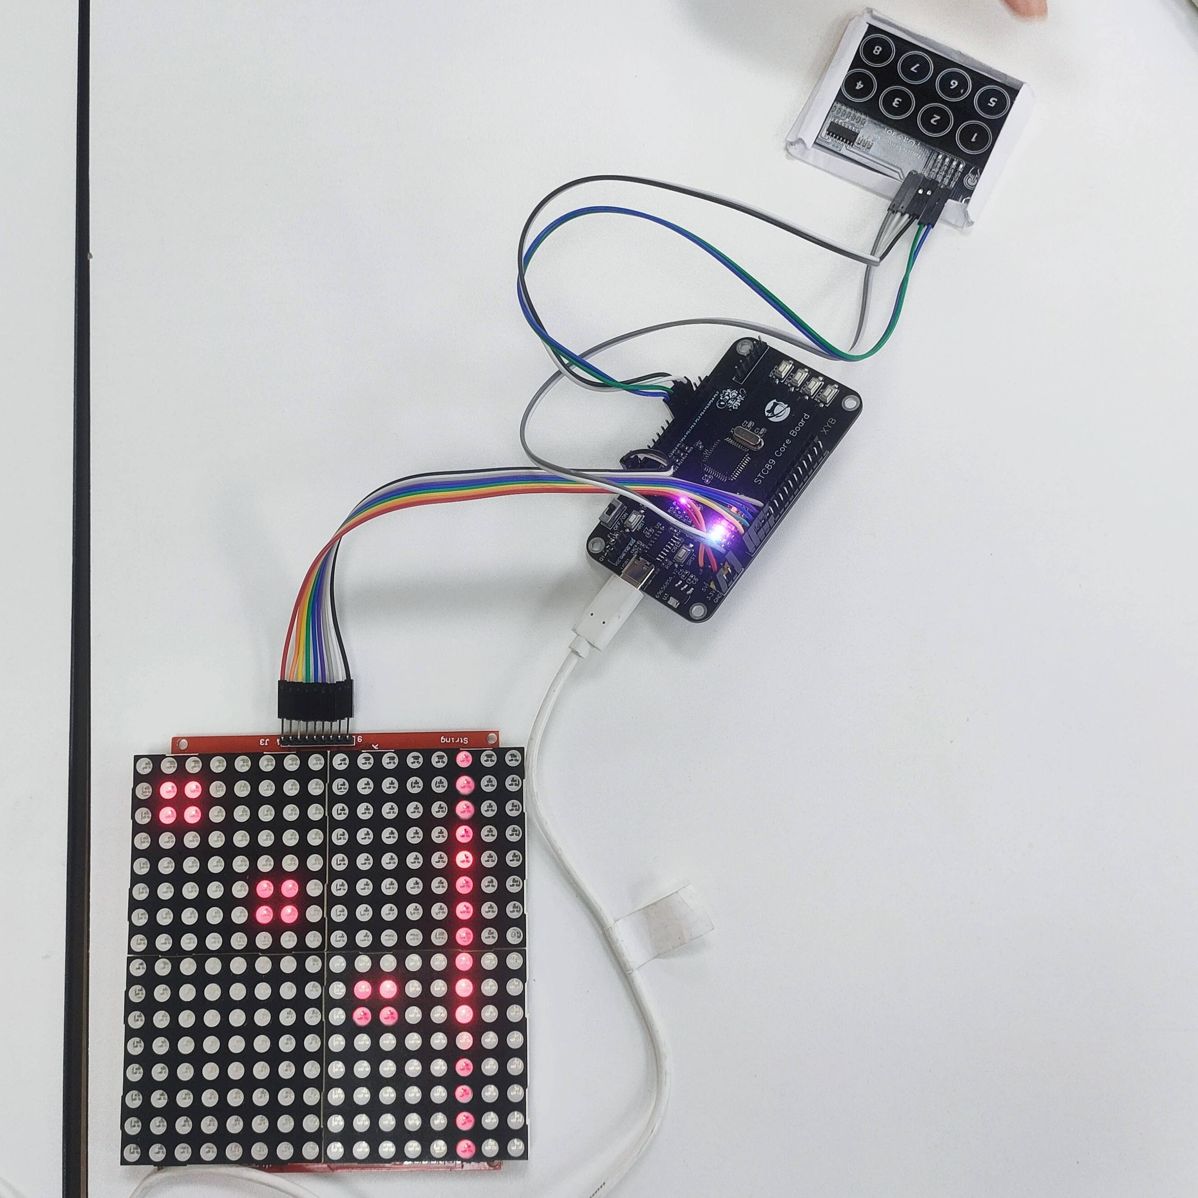
Display
Minimal Implementation
A simple "Punch the Red" game feature was implemented for a small amount of money

Slide 5
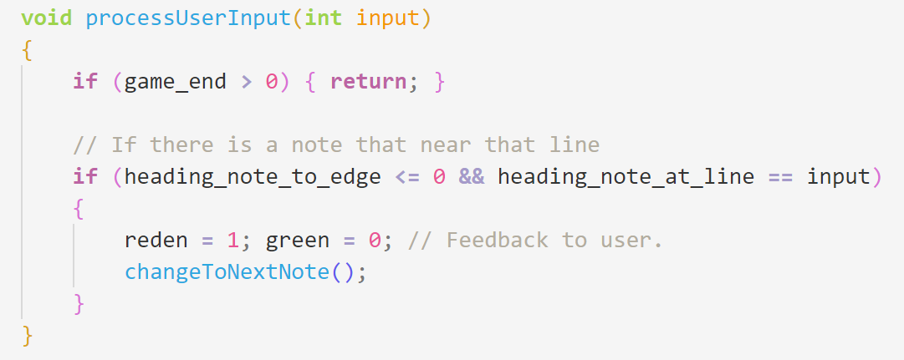
User Experience
Change the LED to green for a short while, and the user can get the response while the gameplay is not hugely influenced.

Slide 6
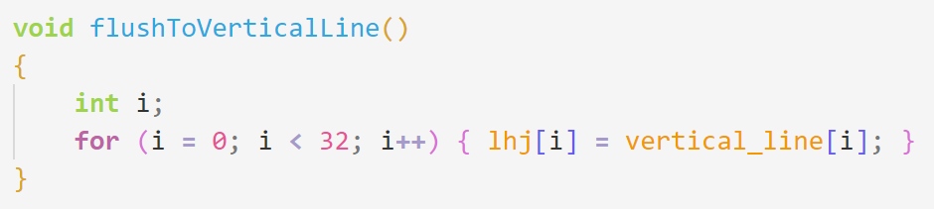
User Experience
To directly display the verticle line, and not put that at the edge (2 points from edge), so the user will still have chance to get one note even after it is moving after the line.

Slide 7
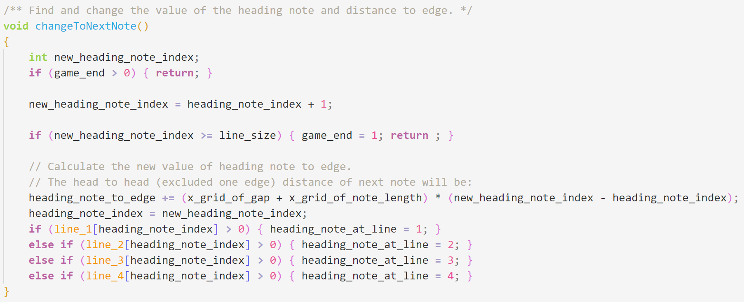
User Experience
Considered about the limitation of the hardware performance. To increase the rate of frame of the project so user can get a better experience.

Slide 8
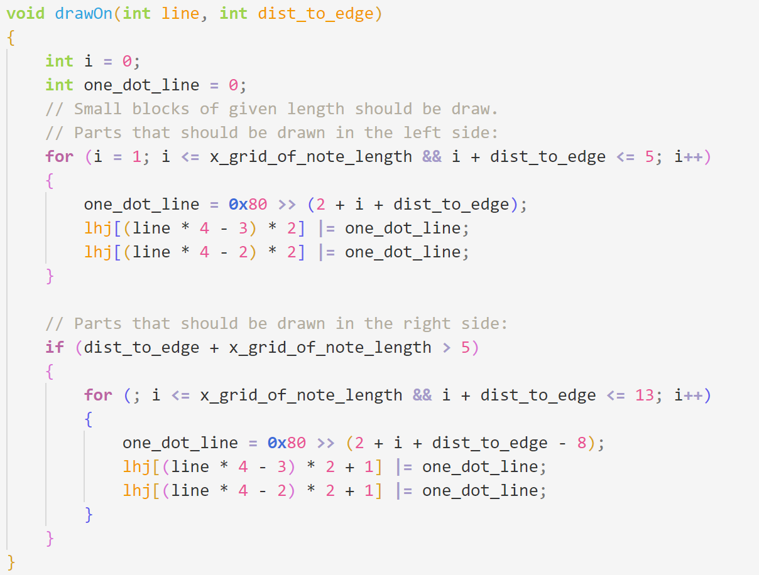
User Experience
Also considered the hardware performance.Use the bitwise operation to speed up the calculation as much as possible.

Slide 9
Drawback
We looked at the implementation possibilities, for example, that remote call we could say could be implemented with RPC, but we didn't actually test it because we didn't have enough money.
Due to hardware memory limitations (only 512 bytes), we can only compile code in C, not in other languages, and debug is also limited.
In order to prevent the memory from reading too many times, it is Assembler oriented programming to compress the memory by putting unnecessary functions such as basic line refresh into the code if they can be put into the code, but not into the memory

Slide 10
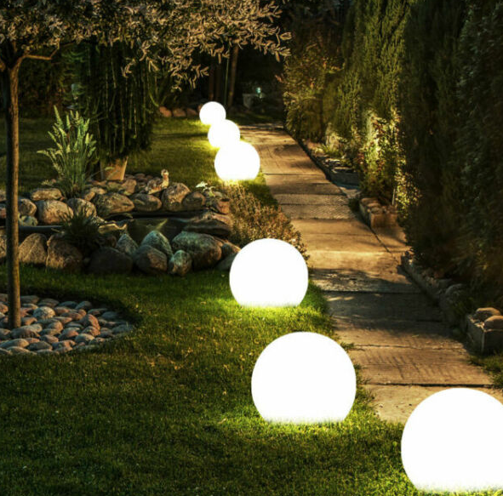
Future Expectation
Spread some of these floor lights on the school lawn, and the change of these lights is more obvious in the dark environment at night.
What's more, watching the lawn lights change (or even fountains erupt) through the classroom window is a great way to relax after studying.
https://www.pinterest.com/pin/22588435623851019/

Slide 11
Thanks
References:
1. https://zh.wikipedia.org/wiki/File:Whac-A-Mole-Dog.jpg
2.https://www.pinterest.com/pin/22588435623851019/
Uploaded link: https://b23.tv/eQ2d7k8

